Slide 1





PRESENTATION
Beyond the Bun: A Data-Driven Nutritional Analysis
From Raw Data to Actionable Health Insights

Slide 2



Project Overview & Objectives
What is the project about?
Analyzing the nutritional content of the McDonald's menu (138 items).
Moving beyond basic calorie counting to understand "Quality of Calories" (Protein efficiency, hidden fats, and sugar spikes).
The Goal:
To identify healthy alternatives vs. marketing myths.
To provide a data-backed guide for muscle building and heart health.

Slide 3


Data Source & Origin
Nutrition Facts for McDonald's Menu" Dataset
Scope of Data:
Contains 260 items (before cleaning).
Includes 9 distinct categories (Breakfast, Beef & Pork, Chicken & Fish, Beverages, etc.).
Features 24 nutritional variables per item (including Calories, Cholesterol, Sodium, Sugar, Protein, and Vitamins).
Data Quality: The raw dataset provided a realistic challenge, containing mixed data types and outliers that required cleaning with Python.
Source: Kaggel

Slide 4


Why This Dataset?
1
Why I chose it:
Public Health Impact: Fast food is a major part of modern diets; analyzing its "hidden" risks is socially relevant.
Richness: It offers deep nutritional details (Micros & Macros), allowing for complex SQL analysis beyond simple calorie counting.
Technical Fit: Perfect for demonstrating full-stack analysis (Python Cleaning + SQL Casting + Power BI Visualization).
2
General Insights:
The "Healthy" Trap: Some "Chicken" and "Salad" items have higher sodium levels than burgers.
Hidden Risks: Items labeled "0g Trans Fat" often hide dangerous levels of Cholesterol.
Volume vs. Density: The physically largest items are not always the most caloric; sugar density in beverages is a critical finding.

Slide 5
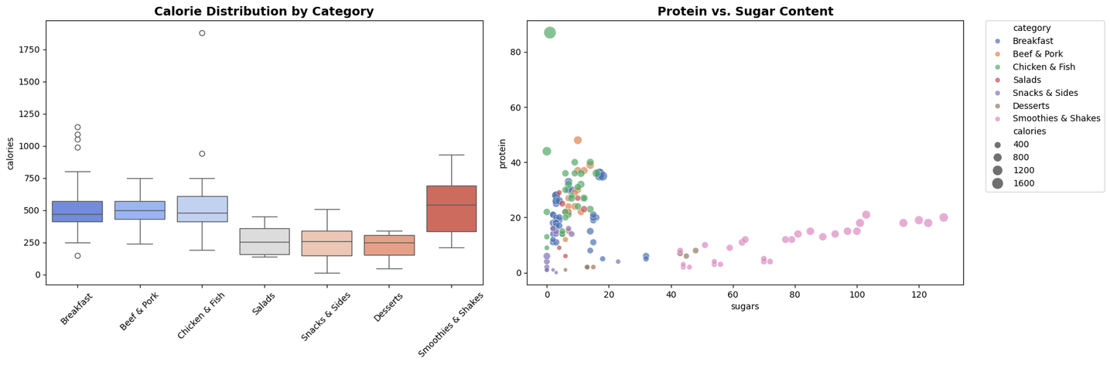
Python Data Cleaning
The Challenge: The raw data contained outliers that skewed averages (e.g., extremely high calorie values).
The Solution:
Used Pandas to load and inspect data.
Applied the IQR Method (Interquartile Range) to mathematically identify and handle outliers.
Visual Proof: [Insert the "Before vs. After" Boxplot image you generated in Python]
Result: A clean, statistically valid dataset ready for analysis.
Here The link For the
( Python NoteBook )

Slide 6

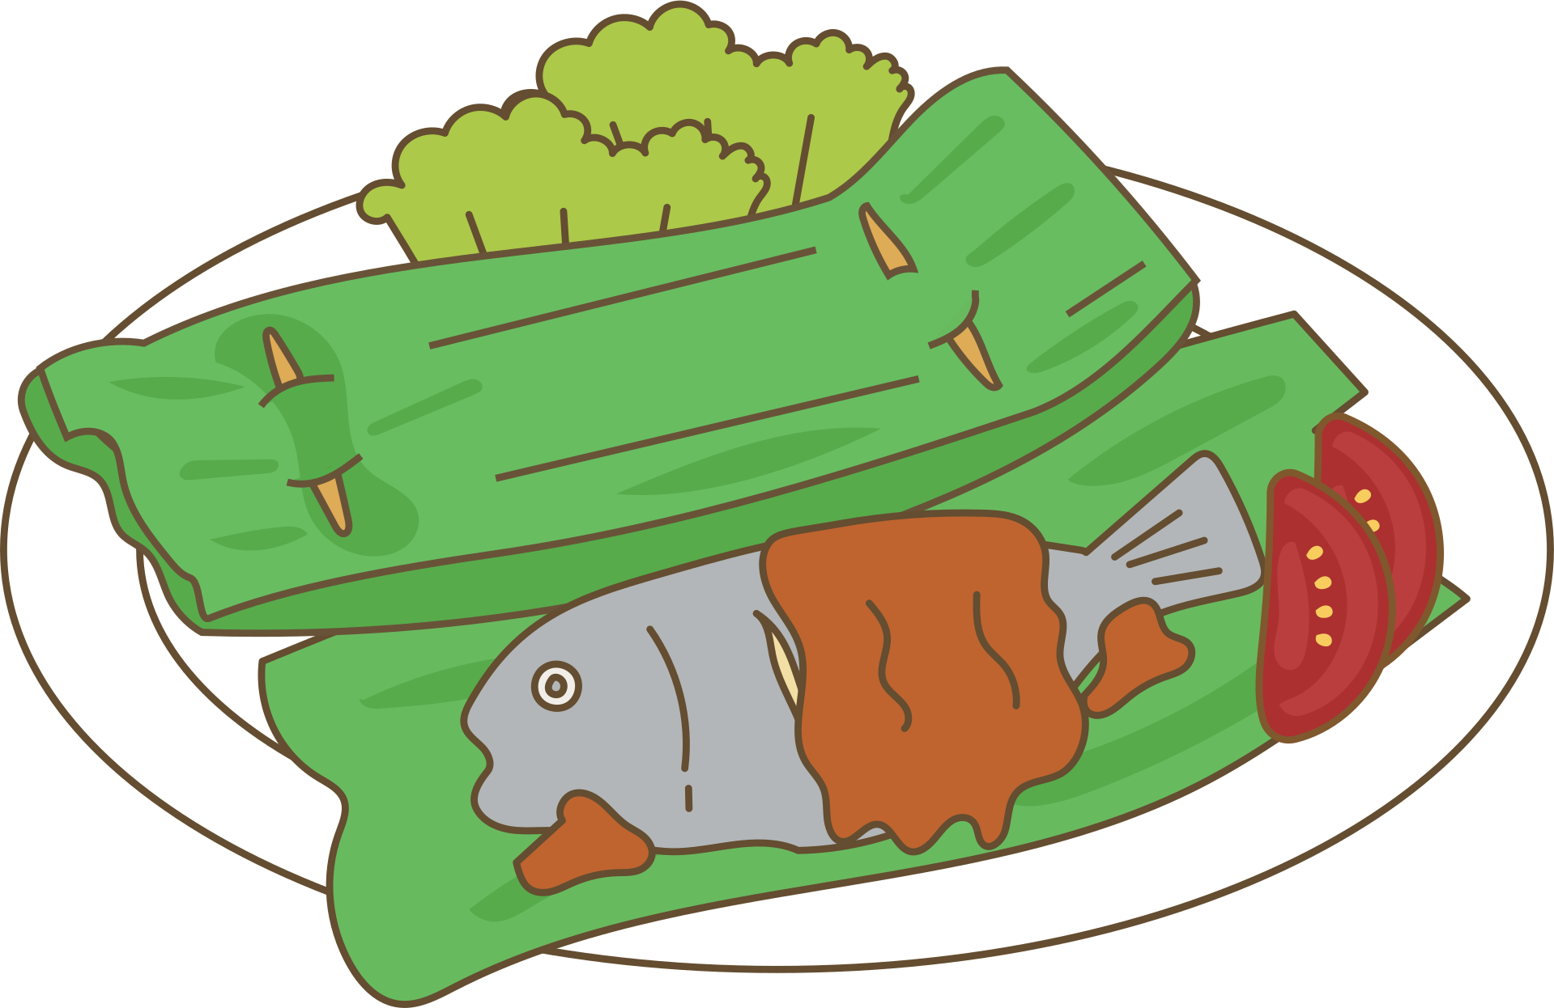
SQL Analysis Strategy
Technical Highlights:
Casting: Converted text fields to FLOAT to allow mathematical aggregation.
Complex Filtering: Used logic like WHERE Trans_Fat = 0 AND Cholesterol > 100 to find contradictions.
Ranking: Used ORDER BY and TOP N to identify "Best" and "Worst" offenders.

Slide 7
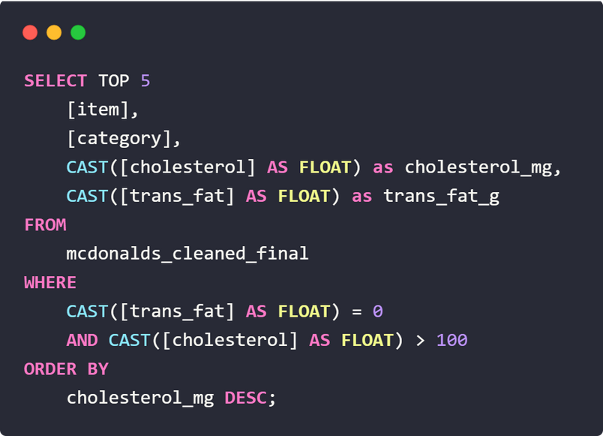
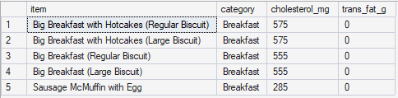
The "Hidden Heart Risk"
The Myth: "No Trans Fat" = Heart Healthy.
The Data Reality: We found items with 0g Trans Fat but >500mg Cholesterol.
Impact: Consumers are misled into thinking these items are safe for their heart.

Slide 8
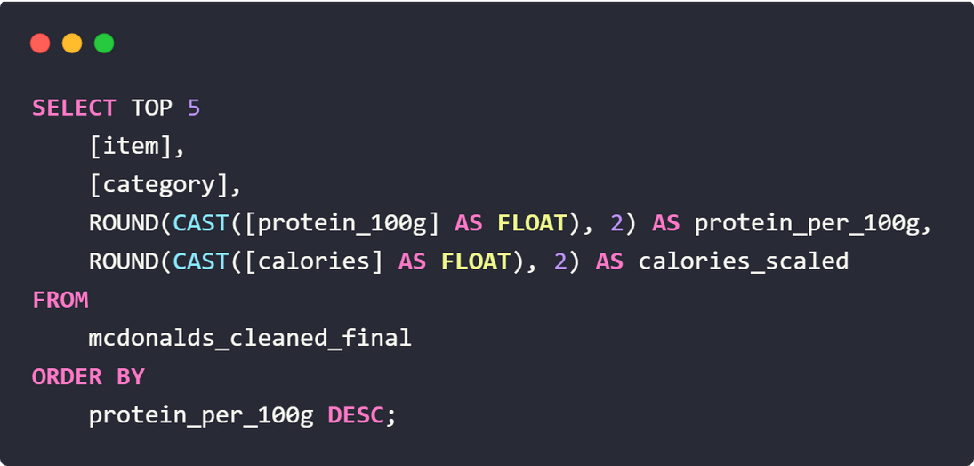
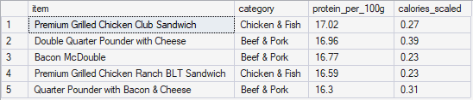
The "Fitness Choice"
The Goal: Maximizing protein intake with minimum calories.
The Discovery: The Egg White Delight and Grilled Chicken offer more protein per 100g than the Double Quarter Pounder.

Slide 9
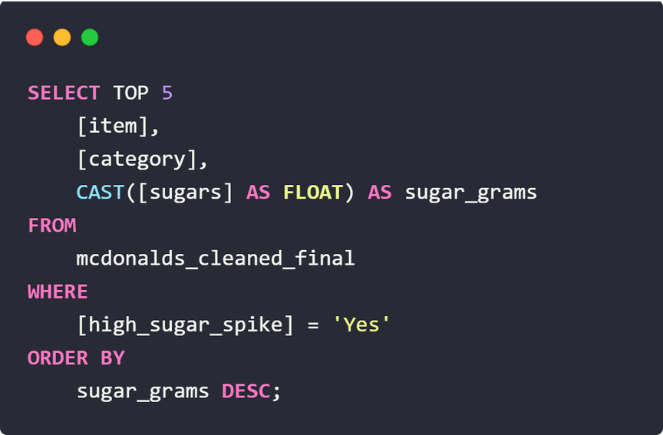
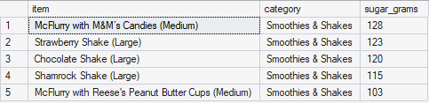
The "Sugar Spike" Warning
The Danger: Liquid calories (Shakes/Frappés) digest faster and spike insulin.
The Findings: 5 specific items contain more sugar (70g+) than 2 cans of soda.
Recommendation: These should be classified as "Desserts," not "Beverages."

Slide 10


Power BI Dashboard Architecture
Features Implemented:
Navigation: Custom buttons to switch between "Executive Summary" and "Detailed Report."
Interactivity: Slicers to filter by Category (Breakfast, Coffee, etc.).
Dynamic Narratives: Smart Text that auto-updates based on selected data.

Slide 11
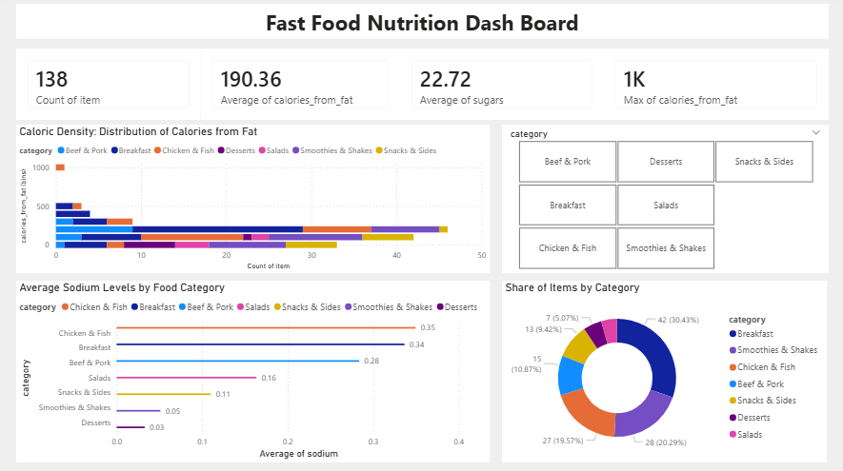
Dashboard Showcase

Slide 12
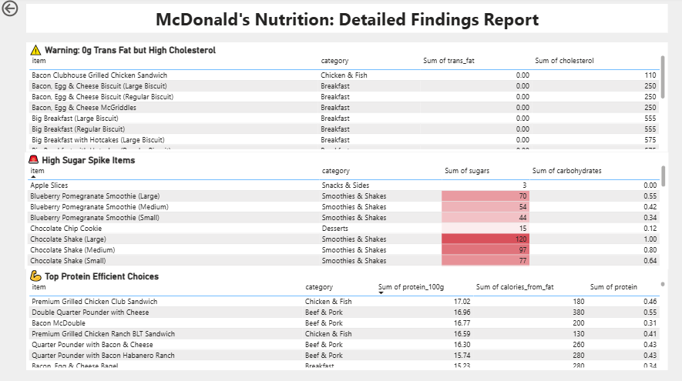
Detailed Report
Use Case: Managers can search for specific items (e.g., "McMuffin") to audit their nutritional values.

Slide 13
Challenges & Technical Solutions
Challenge 1: Data Types in SQL.
Fix: Used CAST(Column AS FLOAT) to fix "Varchar invalid for AVG" errors.
Challenge 2: "Messy" Visuals in Power BI.
Fix: Switched from Treemaps to Doughnut chart and used "Top 10" filtering to reduce noise.
Challenge 3: Outliers in Python .
Fix: Used Python IQR logic to ensure the "Average Calorie" KPI wasn't skewed by extreme items.

Slide 14
Conclusion
The Conclusion:
The McDonald's menu is highly polarized: it contains both highly efficient protein sources and hidden health traps.
"Healthy-sounding" labels (like Zero Trans Fat or Chicken) are not reliable indicators of overall nutritional quality.
Actionable Recommendations:
For Heart Health: Always check Cholesterol even if Trans Fat is 0. Avoid the "Big Breakfast" items which exceed daily limits in a single meal.
For Muscle Building: Prioritize Grilled Chicken and Egg White items. They offer the best protein-to-calorie ratio, whereas big burgers are "calorie expensive."
For Sugar Control: Treat Smoothies & Shakes as desserts, not drinks. A single large shake can contain 3x the sugar of a soda.

Slide 15
Final Reflection & Personal Milestone
What this project added to my skills (Technical Growth):
End-to-End Pipeline: I now understand how Python (Cleaning), SQL (Logic), and Power BI (Storytelling) work together as a cohesive system.
Business Acumen: I learned to look for "Insights" (like the Hidden Heart Risk), rather than just reporting "Numbers."
What was new or different for me? (Challenges Solved):
Handling Flat Files: Importing CSVs directly into SQL and fixing schema/data type issues was a new technical challenge I successfully solved.
Advanced DAX: Creating bins for Histograms and custom metrics like "Protein per 100g" were techniques I applied for the first time.
Personal Milestone (The Journey):
First Step: This was my very first end-to-end Data Analysis project.
Career Inspiration: The excitement of uncovering hidden stories in the data has confirmed my passion for this field. It has inspired me to keep learning and officially kickstart my career as a Data Analyst.

Slide 16


Q&A
Time

Slide 17
Thank
You
FOR YOUR ATTENTION AND TIME
The goal is to turn data into information, and information into insight.
Special thanks to Eng. Dina Mohsen
Project created by: Amr Khaled
NTI Data Analysis

